Slide 2
MICROSOFT EXCEL
- Microsoft Excel is a program made by Microsoft that lets you make spreadsheets. It composes of rows and columns to organize and allows you to do math functions.
- It works with both Windows and Mac operating systems.
- It is one of the most convenient spreadsheets which allows us to store, represent and create data in almost possible way such as tabular, and form, creating optically logical charts, thus managing and manipulating data.

Slide 3
EXAMPLE OF USES EXCEL:
Data analysis
Data management
Accounting
Budgeting
Visuals and graphs
Analysis
Data entry
Programming

Slide 4
MICROSOFT EXCEL FEATURES:
AutoFormat - This feature allows users to utilize excel tables conditional format and formatting options.
AutoSum - By adding an addition formula for a set of cells, the AutoSum function enables us to determine the sum of a row or column automatically.
List AutoFill - When a new item is added to the end of a list, this feature automatically creates excel formatting.

Slide 5
MICROSOFT EXCEL FEATURES:
AutoFill - This function enables us to easily fill cells with repetitive or sequential data, such as repeated documents and chronological dates or numbers. Functions can also be copied using AutoFill. With this feature, we can easily change numbers and text.
AutoShapes - AutoShapes feature helps us in creating geometrical shapes, flowcharts, stars and etc. Considering these shapes we can also draw our graphs.

Slide 6
MICROSOFT EXCEL FEATURES:
Wizard - It displays helpful ideas and approaches depending on our work to assist our work more efficiently. Drag-and-drop lets us move records and text with the mouse.
Charts - This feature will help you to present the data in graphical form by using excel charts Pie, Bars, Line charts, and more.
Shortcut Menus - The shortcut menu lets users complete lengthy tasks with shortcuts.
Notes:
Wizard -

Slide 7
MICROSOFT EXCEL FEATURES:
PivotTables - It flips and sums data in seconds and lets us analyze data and create periodic financial accounts, statistical records, etc. Graphically examine complex data relationships.

Slide 8
MICROSOFT EXCEL WINDOW COMPONENT:
Before you start using it, it’s really important to understand what’s where in its window.

Slide 9
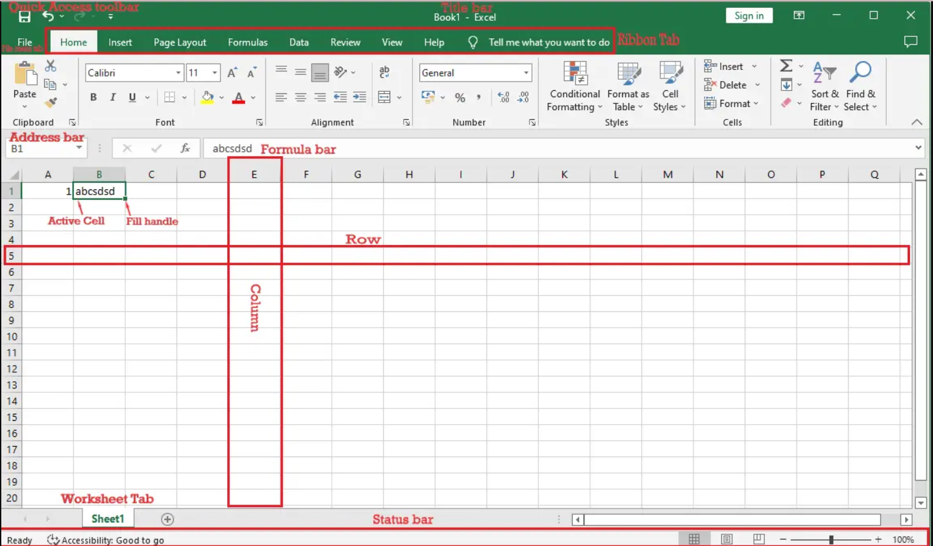

Slide 10
Title Bar: It shows the title name of the workbook together with the application extension.
Quick Access Toolbar: Its feature allows you to customize your frequently used and important tools.
Active Cell: A cell that is currently selected. It will be highlighted by a rectangular box and its address will be shown in the address bar. To edit a cell, you double-click on it or use F2 as well.

Slide 11
Columns: A column is a vertical set of cells. A single worksheet contains 16384 total columns. Every column has its own alphabet for identity, from A to XFD.
Rows: A row is a horizontal set of cells. Every row has its own number for identity, starting from 1 to 1048576.
Fill Handle: It’s a small dot present in the lower right corner of the active cell. It helps you to fill numeric values, text series, insert ranges, insert serial numbers, etc

Slide 12
Address Bar: It shows the address of the active cell. If you have selected more than one cell, then it will show the address of the first cell in the range.
Formula Bar: The formula bar is an input bar, below the ribbon. It shows the content of the active cell and you can also use it to enter a formula in a cell.
File Menu: It contains options like (Save, Save As, Open, New, Print, Excel Options, Share, etc).
Status Bar: It is a thin bar at the bottom of the Excel window. It will give you instant help once you start working in Excel.

Slide 13
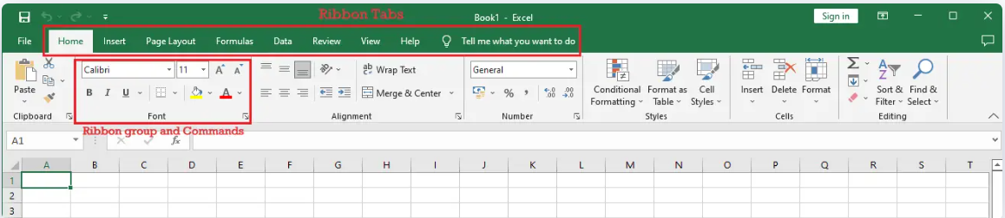
Excel has two structures the ribbon and the worksheet..
EXCEL RIBBON OVERVIEW
Excel uses a tabbed Ribbon system instead of traditional menus. The Ribbon contains multiple tabs, each with several groups of commands. You will use these tabs to perform the most common tasks in Excel.

Slide 14
WORKSHEET
The Sheet is a set of rows and columns. It forms the same pattern as we have in math exercise books, the rectangle boxes formed by the pattern are called cells.
The values can be typed in cells and they could be numbers or letters.

Slide 15
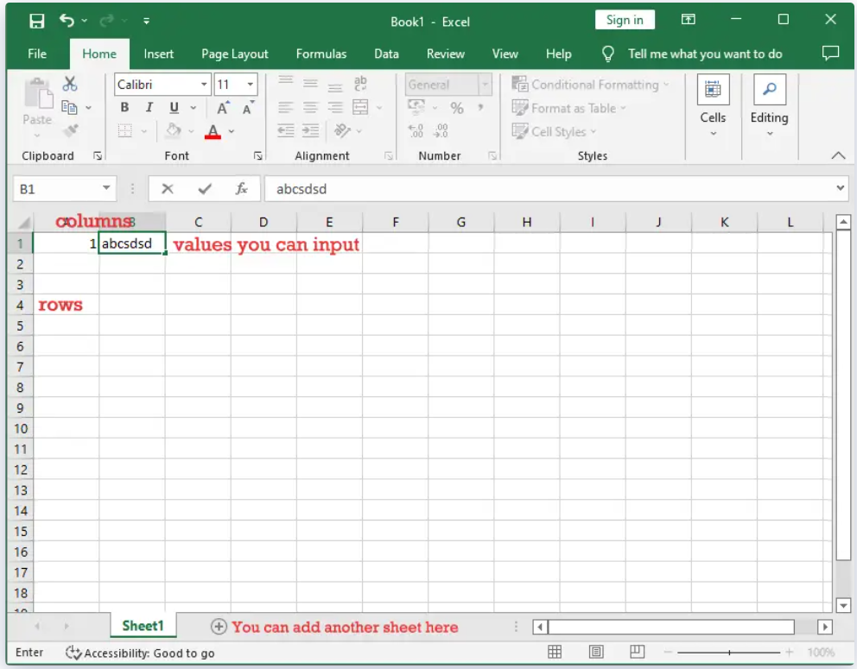

Slide 16
REFERENCES
Website:
Fungsi Motherboard Processor Memori Dan Harddisk | Computer hardware, Computer hardware store, Computer Pinterest. https://www.pinterest.ph/pin/88594317657692933/?mt=login
Unit 4 - Hardware & Ergo - Davids BTA30 Portfolio 2016 Sites.google.com. https://sites.google.com/site/davidsbtaportfolio/unit-4---hardware-ergo.
Computer Software Icon #229946 - Free Icons Library. Icon-library.com. https://icon-library.com/icon/computer-software-icon-14.html
https://edu.gcfglobal.org/en/word2016/understanding-onedrive/1/
https://www.rapidtables.com/code/text/ascii-table.html
https://www.vskills.in/certification/tutorial/ms-word-interface-and-editing-document/
https://itsourcecode.com/ms-word/ms-word-window-explore-its-features/

Slide 17
--- END ---

